Slide 1


Titolo presentazione sottotitolo
MyTaxiService
Milano, XX mese 20XX
Project Plan document

Slide 2
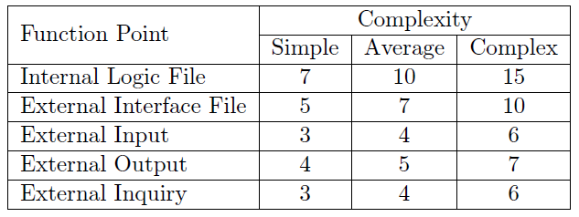
Function Points Approach
Internal Logic File: it represents a set of homogeneous data handled by the system. In our application, MyTaxiDriver, in this category are included all the data structure saved into the database.
External Interface File: it represents a set of homogeneous data used by the application but generated and handled by external application. In our application, MyTaxiDriver, in this category is included the map service oered by GoogleMaps.
External Input: elementary operation to elaborate data coming from the external environment.
External Output: elementary operation that generates data for the external environment
External Inquiry: elementary operation that involves input and output. operations.

Slide 3
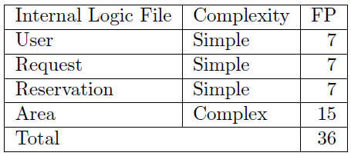
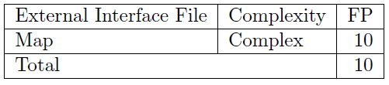
Internal and External Logic Files
Only little information is stored about users. Request and Reservations are stored in order to have an history with little informations.
Areas are considered complex due to the presence of the queue.
The application has to manage maps coming from the external interface provided by GoogleMaps.

Slide 4
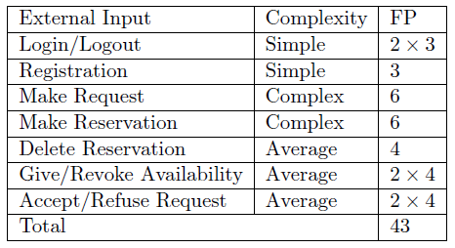
External Input
Login/Logout: simple operations
Registration: simple operation
Make request: complex due to interaction with many different entities
Make reservation: complex due to the fact that involves a request
Delete reservation: average because requires the retrieval of the list of reservations
Give/Revoke availability: average because they involve TaxiDriver and QueueManager
Accept/Refuse request: average because they involve TaxiDriver, Request, and QueueManager.

Slide 5
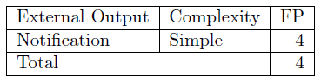
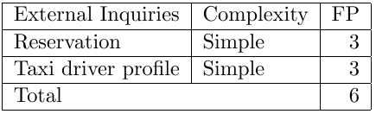
The only output are notifications.
Reservation: registered passengers retrieving the list of reservations
Taxi Driver: availability set

Slide 6
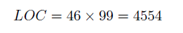
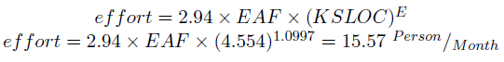
COCOMO
COCOMO is needed to estimate the effort of the project.
We calculated 99 Function Points. We then estimated the LOC with an average conversion factor of 46, appropriate for J2EE.
We considered our application with all «nominal» Cost Drivers and Scale Drivers. Therefore we set the Effort Adjustment Factor to 1.00 and E to 1.0997

Slide 7
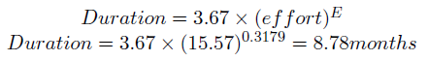
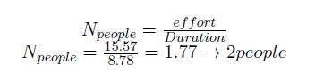
COCOMO
We can then calculate the expected duration of the project in months
And finally we can estimate the number of people needed to complete the project

Slide 8
Tasks
T1.Requirements Analysis and Specification: analysis of the requirements submitted by the customer
T2.Design definition: architecture choice
T3.Test Plan: which and when test the components
T4.Project Plan: estimated time of the project along with possible risks
T5.Development of system: coding part of the project
T6.Unit testing: test of the code
T7.Integration testing: test of functionalities across entities and subsystems
T8.System testing: global functionalities and performance tests

Slide 9
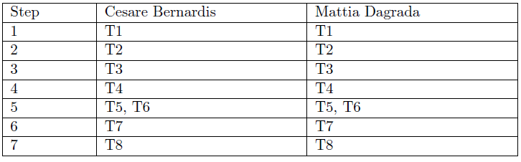
Allocation
Due to inexperience we thought it was better to analyze together the different parts of the project in order to share individual knowledge. The coding part due to its nature will be split between the two of us.
Steps 1 to 4: preliminary documents, we will think together about what to do and then split in parts in order to write them.
Step 5: one will do the Client and Frontend system, while the other will do Backend and Database interface.
Step 6 and 7: all the code must be complete in order to do these.

Slide 10
Risks and Recoveries
Schedule: difficulties following the schedule. Can lead to increase in effort and cost
Technology: requirements may be higher than expected. A good strategy is to overestimate them.
Lack of experience: parts can result too difficult
Budget: initial budget not enough to cover the complete deployement.
We will adopt a proactive strategy, that tries to avoid risk in advance
instead of trying to solve them after they are already become a problem.

